Slide 1
Unit B
Human Form & Function
Body systems
The nervous system

Slide 2

Study Guide
Human Perspectives

Slide 3
Divisions of the nervous system
Nervous System
Central NS (CNS)
(Brain-Spinal cord)
Peripheral NS (PNS)
Afferent (Sensory NS)
Efferent NS
Somatic (motor) NS
All voluntary
Autonomic NS (ANS)
All involuntary
Parasympathetic NS
Sympathetic NS

Slide 4
Neurones
Neurones, also known as neurons (American), or nerve cells, are the highly specialised cells of the nervous system. They generate electrochemical nerve impulses and carry information from one part of the body to another.

Slide 5
Glial tissue
Around 40% of the brain and spinal cord consist of glial cells.
Glial cells support , protect and provide neurones with nutrition, and insulate them from each other.

Slide 6
Classification of neurones
Neurones can be classified by:
Function
  Afferent - take nerve impulses from receptors to the central nervous system.
  Efferent - take nerve impulses from the central nervous system to effector structures.
  Interneurones / association neurones – these are the neurones of the central nervous system.

Slide 7
Classification of neurons
Neurons can be classified by:
Structure
  Unipolar – the axon and dendritic fiber are continuous and the cell body lies off to one side. Most sensory neurones are unipolar.
  Bipolar – they have a distinct axon and a dendritic fiber separated by a cell body
  Multipolar – have a single axon and several dendritic fibers. All somatic motor neurones are multipolar.

Slide 8
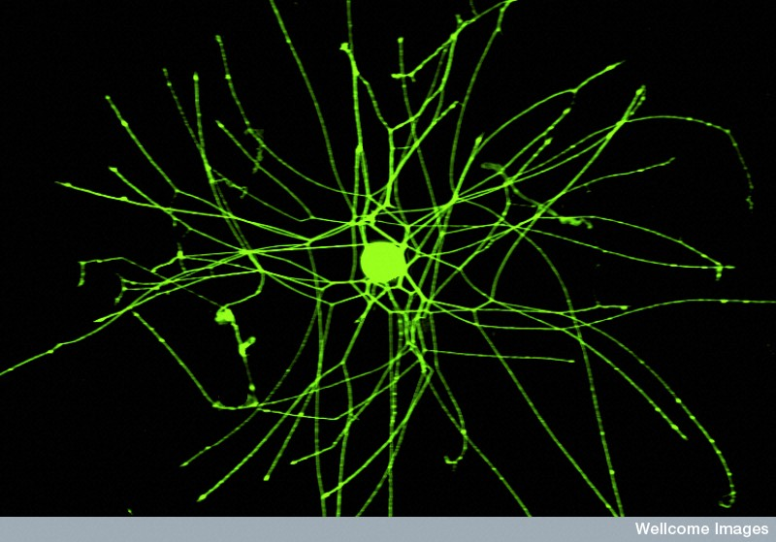
Anaxonic neurones have no distinct axons or dendrites
Isabella Gavazzi, Wellcome Images

Slide 9
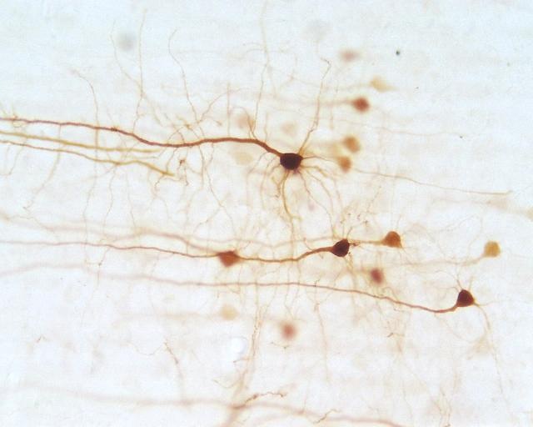
Multipolar motor neurones
Axon
Dendrites
Lutz Slomianka, ANHB, UWA

Slide 10
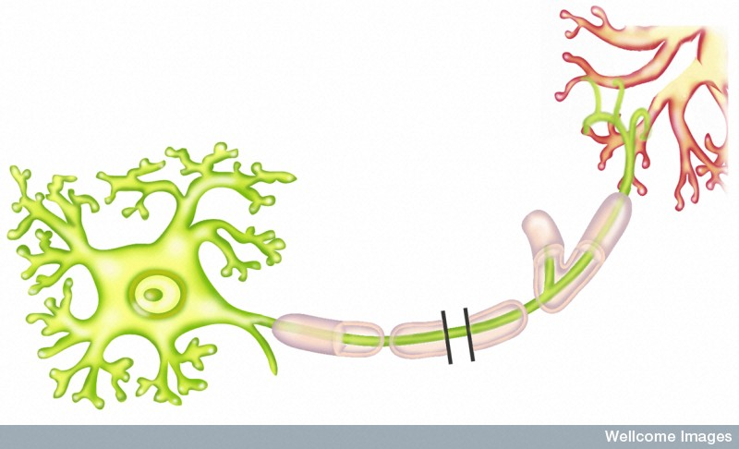
Multipolar efferent (motor) neurone
Dendrites
Synaptic terminals
Cell body
(cyton)
Myelinated axon
Nucleus
Wellcome Photo Library

Slide 11
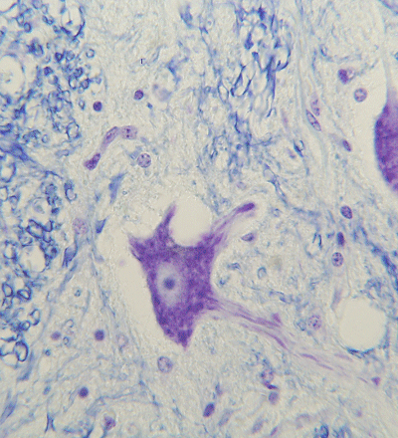
The cell body
The cell body is also known as the soma or cyton.
Granular cytoplasm is due to clusters of ribosomes (Nissl granules)
There are abundant organelles, especially mitochondria.
Dendrites
Cell body
Axon
G Meyer, ANHB, UWA

Slide 12
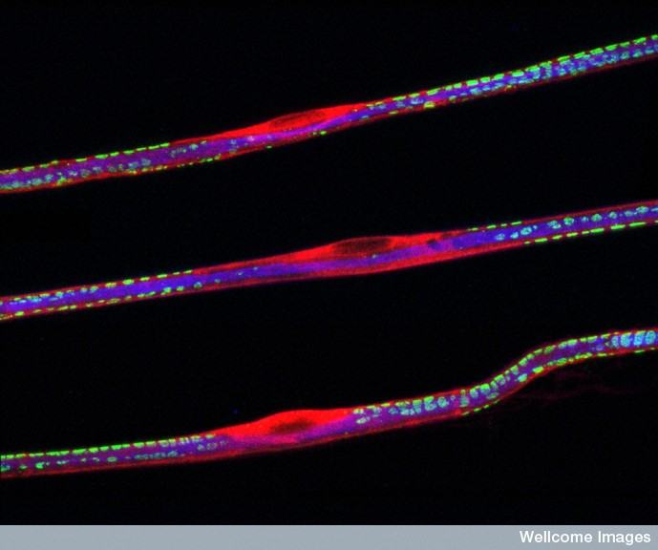
The cytoplasmic processes (nerve fibers)
Dendrites
Usually short and highly branched
Synapse with other neurones or receptors.
Axons
Typically a single, long nerve fiber
Terminate at synaptic end bulbs
Connect with muscles (neuromuscular junction), glands (neuroglandular junction), or other neurones.
EM of nerve fibers
Peter Brophy, Wellcome Images

Slide 13
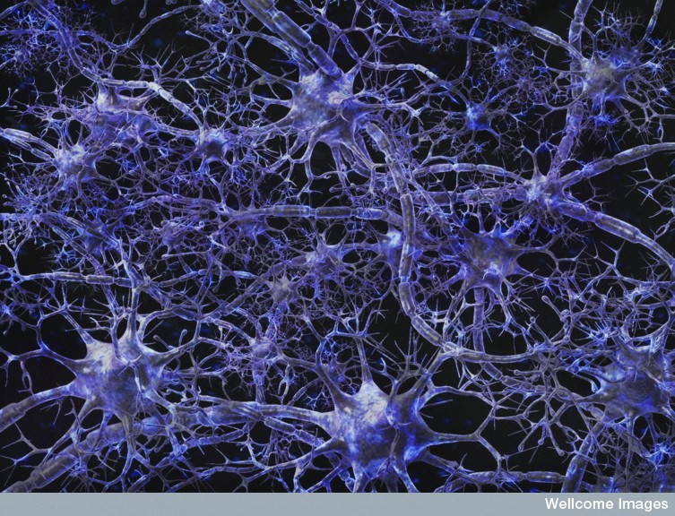
Neurones connect with one another to form complex neural networks
Arran Lewis, Wellcome Images

Slide 14
The myelin sheath
The myelin sheath is a white, fatty sheath surrounding the axon of most neurones.
The myelin sheath of peripheral nerve fibers is produced by Schwann cells (glial cells).
Nerve fibers with a myelin sheath are said to be myelinated.
The myelin sheath speeds up nerve transmission.

Slide 15
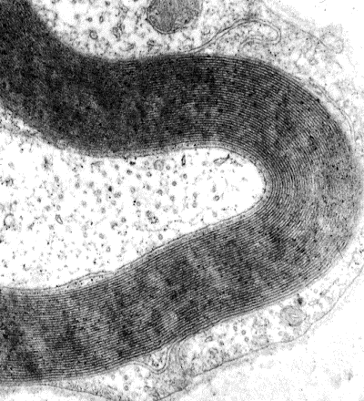
The myelin sheath usually has many layers wrapped around the nerve fiber, rather like a Swiss roll.
Myelin sheath
G Meyer, ANHB, UWA

Slide 16
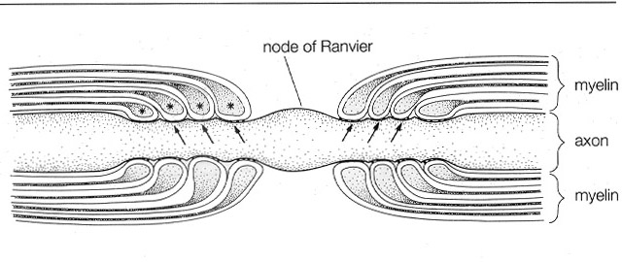
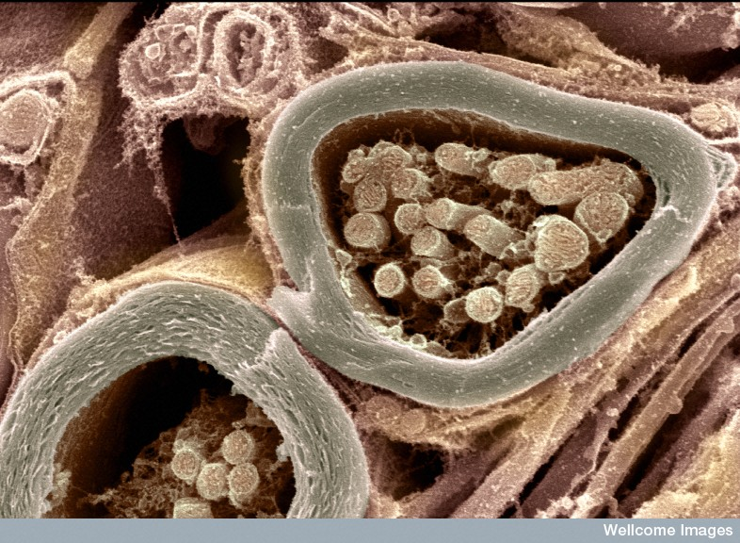
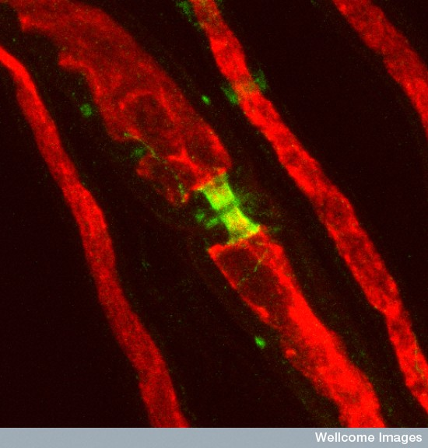
Myelin sheath
Nerve fiber (mostly mitochondria)
Node of Ranvier
Myelin sheath

Slide 17
Features of efferent (motor) neurones
Take nerve impulses from CNS to effectors
Mostly multipolar with a single long axon
Cell body in grey matter of spinal cord
Pass through ventral root of spinal nerves
Effector structures (muscles or glands) occur at end of axons
Dendrites synapse with connector neurones in spinal cord
Can be somatic (voluntary) or autonomic (involuntary)

Slide 18
Features of afferent (sensory) neurones
Take nerve impulses from receptors to CNS
Mostly unipolar with the cell body lying off to one side of the axon
Cell body in dorsal root ganglion
Pass through dorsal root of spinal nerves
Sensory receptors occur at end of dendrites
Axons synapse with connector neurones in spinal cord.

Slide 19
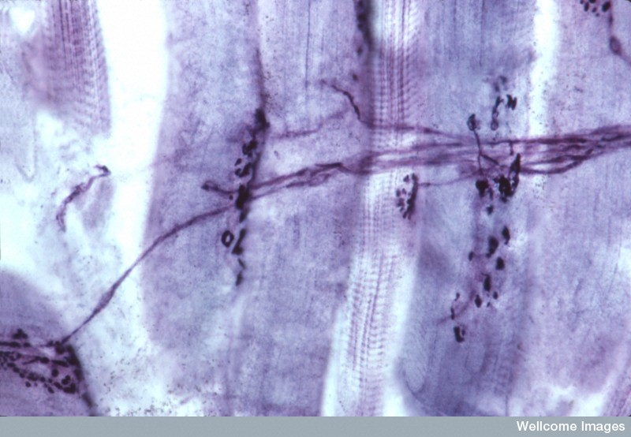
Neuromuscular junction
Neuromuscular junction
Axon
Motor neurones synapsing with muscle cells
M Walker, Wellcome Images

Slide 20
Nerve transmission
Due to different permeability to sodium and potassium, there is a weak electrical charge across the membrane of the neurone (the resting potential) – the membrane is said to be polarised.
When the neurone is stimulated the action of the sodium and potassium membrane pumps is briefly interrupted.

Slide 21
Changes in the permeability of the membrane allows sodium to flood into the cell and potassium to leak out.
This reverses the electrical charge across the membrane (the action potential) – the cell membrane is said to be depolarised.

Slide 22
Nerve impulse transmission
IMPULSE
+
Na⁺
+
Na⁺
_
_
Na⁺
+
Na⁺
+
+
_
_
_
+
_
_
+
K⁺
K⁺
+
Na⁺
K⁺
K⁺
_
+
_
_
K⁺
_
K⁺
+
Na⁺
K⁺
_
K⁺
+
+
_
_
+
Na⁺
+
Na⁺
+
+
Na⁺
Na⁺
Depolarisation

Slide 23
Depolarisation sweeps down the nerve fiber in a sequence of small steps – this is the nerve impulse.
As soon as the nerve impulse passes, the membrane pumps are reactivated and the resting potential restored.
In myelinated fibers the impulse leap-frogs from node to node – this is called saltatory conduction.

Slide 24
Speed of transmission
The speed of nerve impulse transmission is affected by:
The diameter of the nerve fiber
  the impulse travels faster in thicker fibers.
Whether or not the fiber is myelinated
  saltatory conduction in myelinated fibers is faster than continuous conduction in unmyelinated fibers.
Nerve transmission
Nerve fiber
Myelin sheath
Node of Ranvier

Slide 25
Synapses
A synapse is the junction between two neurones, or between a neuroen and a muscle or gland.
Nerve impulse transmission occurs because special neurotransmitter chemicals are released into the tiny gap (the synaptic cleft), which separates the two nerve cells.
Acetylcholine and noradrenaline are the neurotransmitters of the peripheral nervous system.

Slide 26
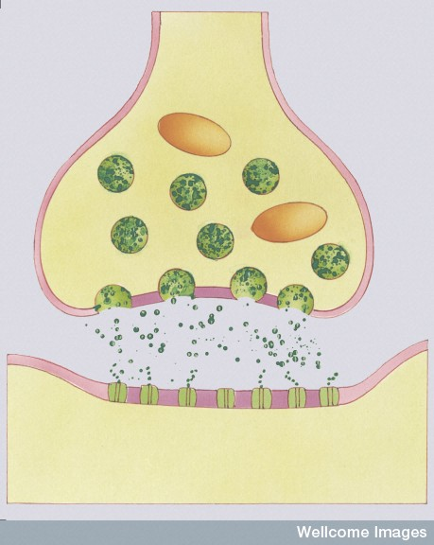
Synapses
Vesicles containing the neurotransmitter move towards the pre-synaptic membrane where they fuse with the cell membrane, releasing their contents into the synaptic cleft. The neurotransmmitter molecules act on the post-synaptic cell by binding to specific receptors on the cell surface.
Vesicle
Pre-synaptic cell
Synaptic cleft
Post-synaptic cell

Slide 27
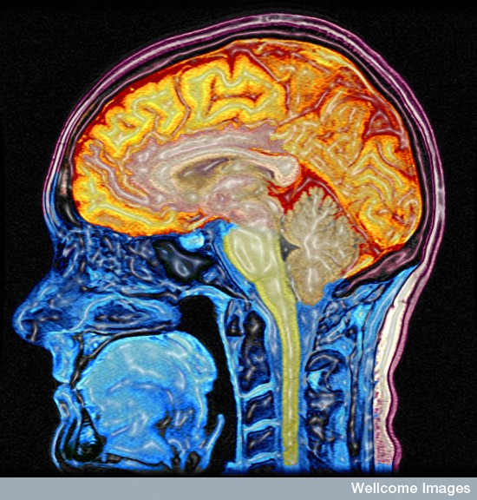
The central nervous system
The central nervous system consists of the brain and the spinal cord
M Lythgoe, C Hutton, Wellcome Images

Slide 28
The spinal cord
The spinal cord is an extension of the medulla oblongata in the brain.
The spinal cord is as thick as your little finger and passes through the vertebral foramen to the level of the second lumbar vertebra.

Slide 29
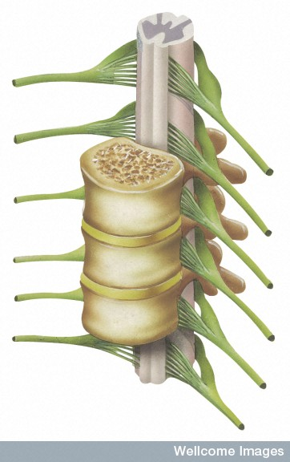
The spinal cord showing associated spinal nerves
Dorsal (sensory) branch
Spinal cord
Dorsal root ganglion
Ventral (motor) branch
Mixed spinal nerve
Backbone

Slide 30
The spinal nerves
31 pairs of spinal nerves arise from the spinal cord.
Close to the spinal cord the mixed spinal nerve splits into a dorsal branch (root) and a ventral branch.
The dorsal branch carries afferent (sensory) fibers.
A swelling on the dorsal branch is the dorsal root ganglion, which contains the cell bodies of the sensory neurones.
The ventral branch carries efferent (motor) fibers.

Slide 31
Grey matter and white matter
The central core of the spinal cord consists of grey matter.
This contains cell bodies and unmyelinated fibers.
Motor and sensory neurones synapse with connector neurones in the grey matter.
The outer part of the spinal cord consists of white matter.
This contains ascending and descending tracts of myelinated nerve fibers.

Slide 32
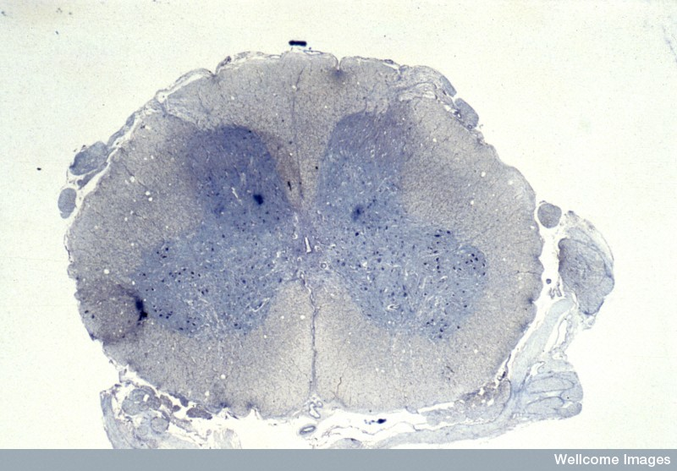
Cross section of the spinal cord
Spinal meninges
Grey matter
White matter
Central canal
Wellcome Photo Library

Slide 33
The brain
The brain is an anterior expansion of the spinal cord.
The following structures comprise the main regions of the brain:
  Brain stem – medulla oblongata, pons & mid brain.
  Diencephalon – thalamus & hypothalamus
  Cerebellum
  Cerebrum

Slide 34
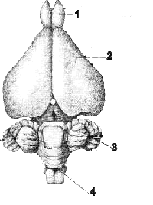
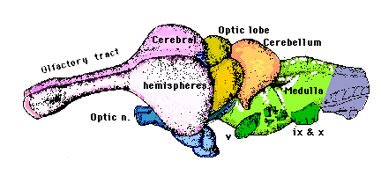
Brain of reptile (right) and rabbit (left)
Olfactory lobe
Cerebrum
Cerebellum
The structure of the brain stem and cerebellum is very similar to those of humans
Brain stem

Slide 35
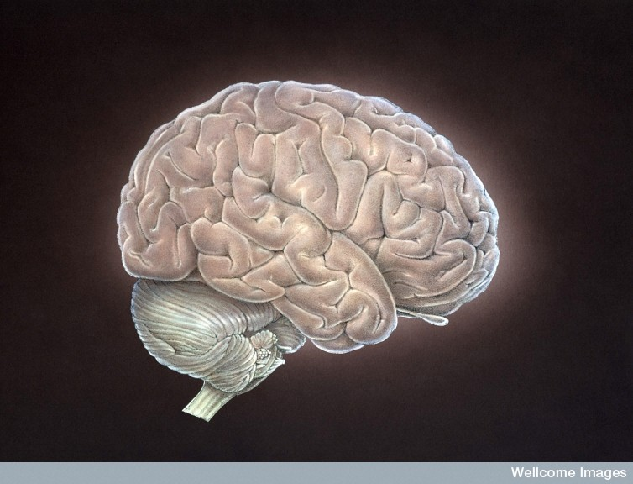
Surface features of the brain
Cerebrum
Central sulcus
Parietal lobe
Occipital lobe
Lateral sulcus
Frontal lobe
Temporal lobe
Cerebellum
Brain stem
Medical Art Services, Munich, Wellcome Images

Slide 36
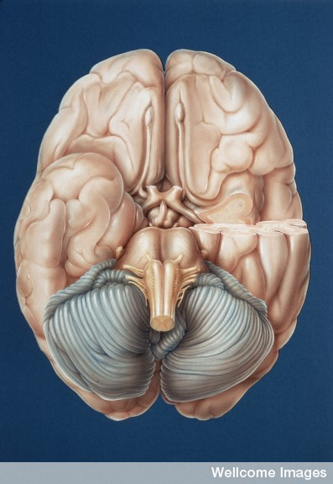
Surface features – inferior view
Cerebrum
Longitudinal fissure
Olfactory tract
Optic chiasma
Pons
Medulla
Cerebellum
Medical Art Services, Munich, Wellcome Images

Slide 37
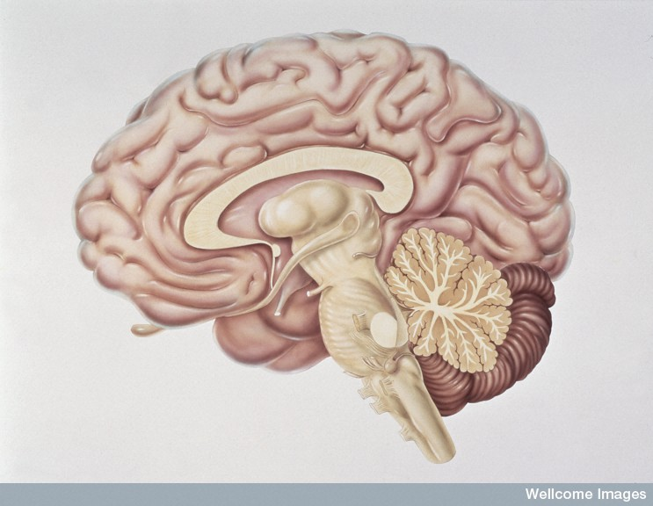
Brain – sagittal section
Right cerebral hemisphere
Corpus callosum
Ventricle
Hypothalamus
Midbrain
Cerebellum
Pons
Medulla oblongata
Spinal cord
Medical Art Services, Munich, Wellcome Images

Slide 38
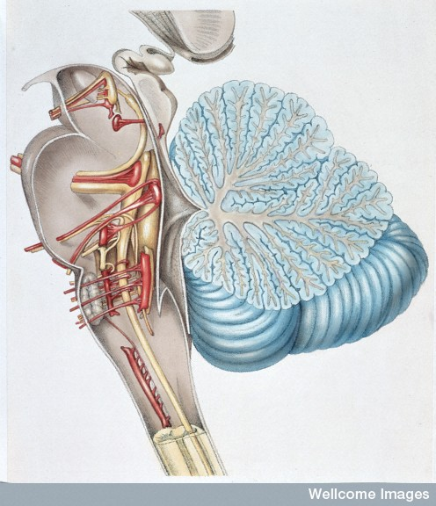
Medulla oblongata
Forms the lower region of the brainstem & wall of 4th ventricle
Several cranial nerves arise here.
Respiratory (MRC), cardiac & vasomotor centers are located here
Contains reflex centers for swallowing, choking etc.
Contains part of reticular formation
(sensory filter & arousal)
Medical Art Services, Munich, Wellcome Images

Slide 39
Hypothalamus
Part of the diencephalon & forms floor of 3rd ventricle
Controls the ANS / Regulates basic body functions (e.g. temperature, thirst, hunger) / Produces hormones / Controls pituitary gland / Part of emotional brain.
Medical Art Services, Munich, Wellcome Images

Slide 40
The cerebrum
Medical Art Services, Munich,
Wellcome Images
Contains:
Sensory areas (perception of sight, hearing, taste, smell, touch etc.)
Motor areas (movement & speech)
Association areas (awareness, memory etc.)

Slide 41
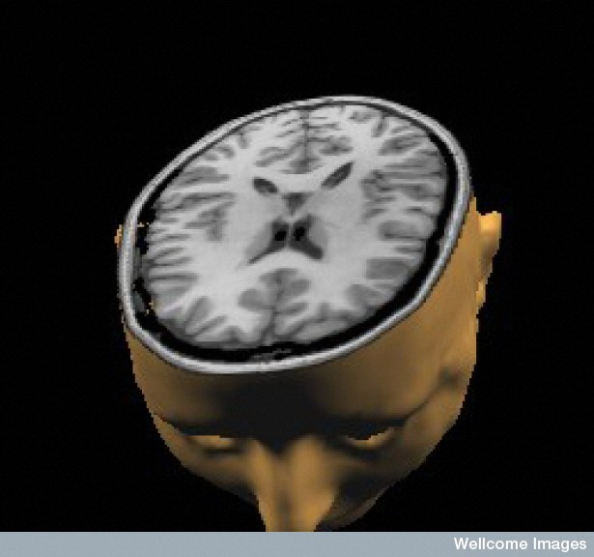
Cerebral cortex
Grey matter
(dark grey)
White matter
(light grey)
MRI of the head showing cerebral cortex (grey matter).
Grey matter consists of synapsing cell bodies.
White matter contains tracts of myelinated nerve fibers
M Lythgoe, C Hutton, Wellcome Images

Slide 42
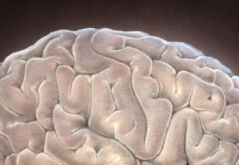
Gyri and sulci
The corrugated surface of the cerebrum greatly increases the surface area of the cerebral cortex.
The corrugations consist of gyri (ridges) and sulci (grooves).
Sulcus
Gyrus
Medical Art Services, Munich,
Wellcome Images

Slide 43
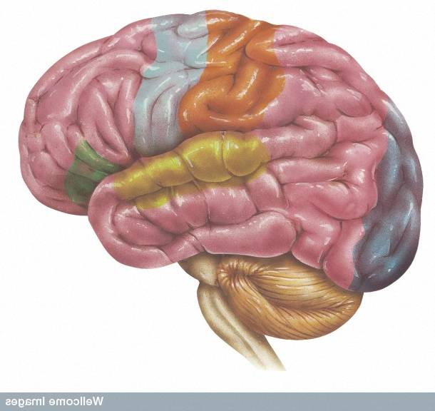
Sensory and motor areas
Primary motor area
(motor)
Primary sensory area
(sensory)
Wernicke’s interpretive area
(sensory)
Broca’s speech area
(motor)
Visual area
(sensory)
Olfactory (smell) area
(sensory)
Auditory (hearing) area
(sensory)
Wellcome Images

Slide 44
Cerebellum
Also known as secretary of the brain.
Co-ordinates fine, controlled motor movement / Controls muscle tone / Stores memory for habitual actions.
Medical Art Services, Munich, Wellcome Images

Slide 45
The cerebrum – frontal lobe
Contains the premotor and primary motor cortex responsible for voluntary control of muscles
Responsible for judgment, emotions, motivation and memory
Medical Art Services, Munich, Wellcome Images

Slide 46
The cerebrum - parietal lobe
Contains the primary sensory strip and sensory association areas.
Damage to this region makes it difficult to understand sensory inputs from the skin.
Medical Art Services, Munich, Wellcome Images

Slide 47
The cerebrum - occipital lobe
The occipital lobe contains the visual areas.
Damage to this area may result in cortical blindness.
Medical Art Services, Munich, Wellcome Images

Slide 48
The cerebrum - temporal lobe
The temporal lobe contains the olfactory (smell) and auditory (hearing) areas.
Medical Art Services, Munich, Wellcome Images

Slide 49
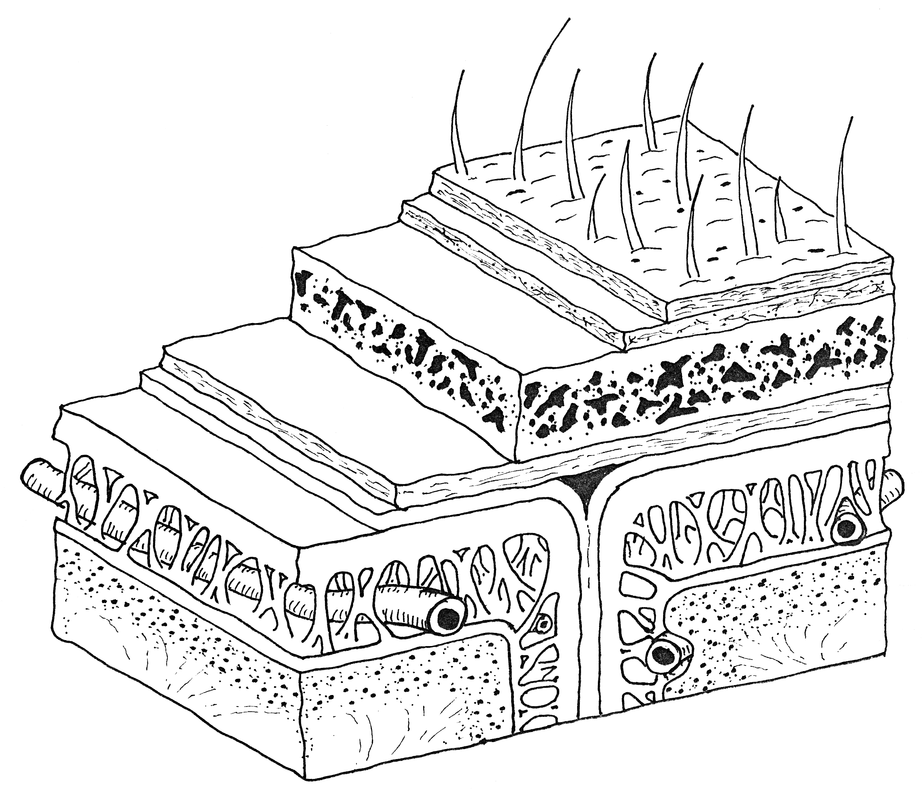
The meninges

Slide 50
The peripheral nervous system
The peripheral nervous system consists of all the nerves in the body, outside the central nervous system.
Peripheral nerves may be:
  Afferent (sensory), taking nerve impulses from receptors to the central nervous system.
  Efferent (motor), taking nerve impulses from the central nervous system to effectors.
  Efferent nerves can be somatic (volutary)
  or autonomic (involutary).

Slide 51
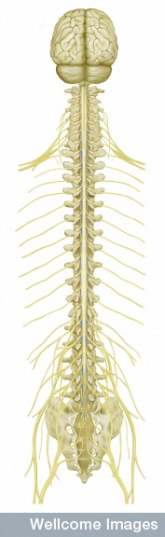
Spinal nerves
There are 31 pairs of spinal nerves.
They pass between the vertebrae and divide into a dorsal (sensory) and a ventral (motor) branch.
Below the 2nd lumbar vertebra the vertebral foramen is occupied by a mass of spinal nerves, the cauda equina, which serve the lower body.
Spinal nerves
Cauda equina
Medical Art Services, Munich, Wellcome Images

Slide 52
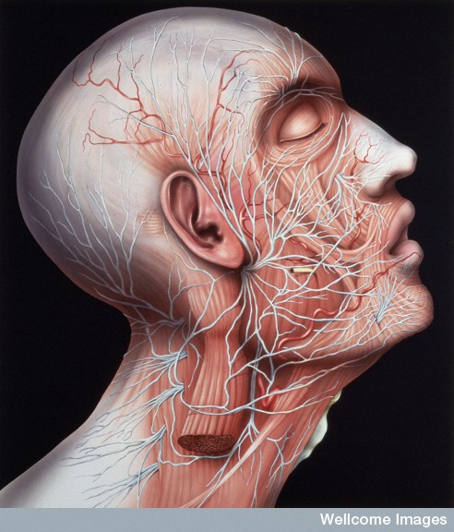
The cranial nerves
There are 12 pairs of cranial nerves that connect directly with the brain.
The cranial nerves may be motor, sensory or mixed.
Medical Art Services, Munich, Wellcome Images

Slide 53
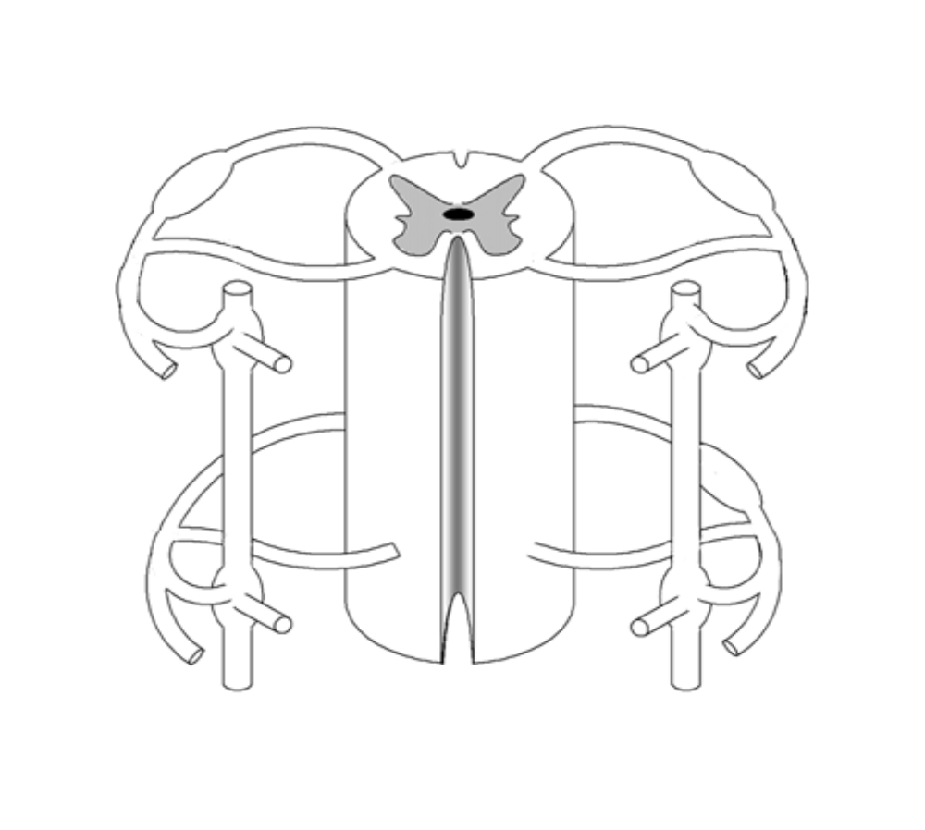
Somatic nerve pathways from the spinal cord
Dorsal (afferent) root
Dorsal root ganglion
Ventral (efferent) root
Mixed spinal nerve
Sensory impulse
Motor impulse
Spinal cord

Slide 54
Reflexes
A reflex is a fast, involuntary response to a stimulus (it does not involve the brain).
A reflex arc is the nerve pathway taken by a reflex.

Slide 55
Simple spinal reflex arc
Sensory neurone carrying nerve impulse from receptor
Connector neuron creating short-cut between sensory and motor neurones
Motor neurone carrying nerve impulse to muscle
Wellcome Photo Library

Slide 56
Unit 3A
Human Form & Function
Body systems
The autonomic nervous system

Slide 57
The autonomic nervous system
Parasympathetic
Sympathetic
Eyes
Salivary
glands
Skin
Blood vessels
Heart
Lungs
Liver
Digestive
system
Spleen
Adrenal glands
Kidneys
Bladder
Genitalia

Slide 58
Autonomic Nervous System
The Autonomic Nervous System :
Is involuntary
Helps maintain homeostatic balance
Carries nerve impulses to involuntary
glands and internal organs
May be sympathetic (fight or flight)
or parasympathetic (normal functioning)
Consists of two neurones form efferent chain
(pre- and post-ganglionic neurones)

Slide 59
The sympathetic division
The sympathetic division of the autonomic nervous system:
Enables the body to respond to stress (fight or flight response) – throws the body out of homeostatic balance.
Arise with spinal nerves in the lumbar and thoracic regions of the spine.
The neurotransmitter is noradrenaline.

Slide 60
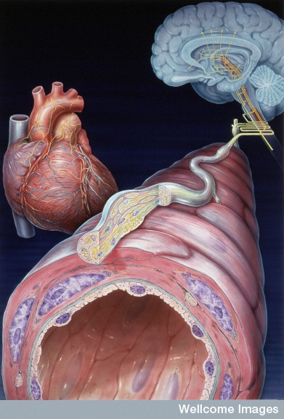
Sympathetic stimulation causes the smooth muscle surrounding arterioles to contract, resulting in vasoconstriction.
Medical Art Services, Munich, Wellcome Images

Slide 61
Spinal nerves and autonomic pathways from the spinal cord
Spinal cord
Dorsal (afferent) root
Dorsal root ganglion
Ventral (efferent) root
Mixed spinal nerve
Somatic efferent nerve pathways
Autonomic efferent nerve pathways
Sympathetic chain
Sympathetic chain ganglion

Slide 62
Parasympathetic division
The parasympathetic division of the autonomic nervous system:
Is involved with normal body functioning
(maintains homeostatic balance).
Arise with cranial nerves from the brain and spinal nerves in sacral region of the spine (= cranio-sacral outflow).
The neurotransmitter is acetylcholine (ACh).

Slide 63
Specific autonomic responses
Sympathetic | Parasympathetic
Release of adrenaline | None
Increased cardiac output | Decreased cardiac output
Dilation of the airways | Constricts airways
Sweating | None
Dilation of pupils | Constriction of pupils
Hairs stand on end (goose bumps/piloerection) | None
Vasoconstriction of peripheral arterioles | Little effect
Fat & glycogen converted to glucose | None
Digestion stops | Stimulates digestion
Secretion of saliva stops | Stimulates secretion
Anal & urethral sphincters contract | Anal & urethral sphincters relax

Slide 64
Hormones and nerve impulses
Hormones | Nerve impulses
Carried in bloodstream | Carried by nerve fibres
Chemical | Electrochemical
Slow response time (seconds/minutes) | Fast response time (milliseconds)
Slow duration (mins/hrs) | Short duration (a twitch)
Specific – only activate specific target structures | Non-specific – can activate any structure in the body
Involuntary | Voluntary

